Slide 1
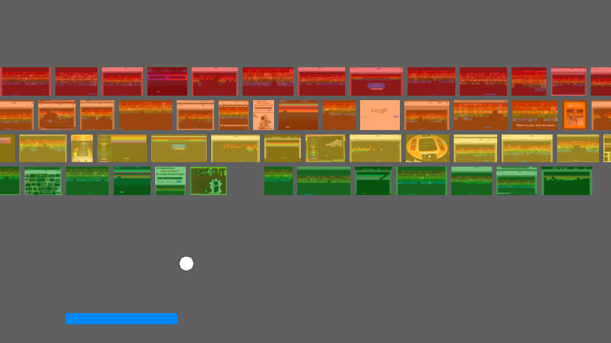
Atari Breakout &
Deep Q-Networks
DS4기 5조
박 봉현, 박 선영, 조 남영

Slide 2
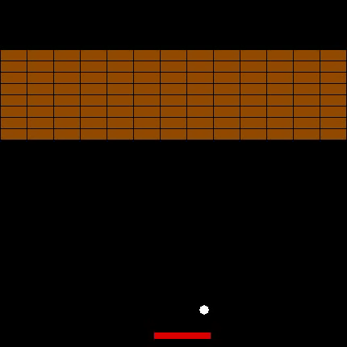
Model Test
Score : 111
Time : 142’ 222
Final Result

Slide 3
Model Tuning
Original DQN
Learning Rate
Batch Size (Final)
-----------------------------------------
History :
-----------------------------------------
Score : 56 (29, 11, 16)
Time : 62
------------------------------------------
-----------------------------------------
History : lr : 0.0001
replay memory : 30000
-----------------------------------------
Score : 86 (61, 4, 21)
Time : 93
------------------------------------------
-----------------------------------------
History : BatchSize : 64
-----------------------------------------
Score : 111 (75, 13, 23)
Time : 140
------------------------------------------

Slide 4
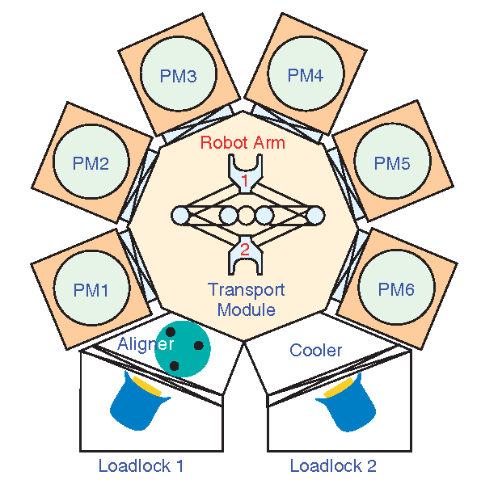
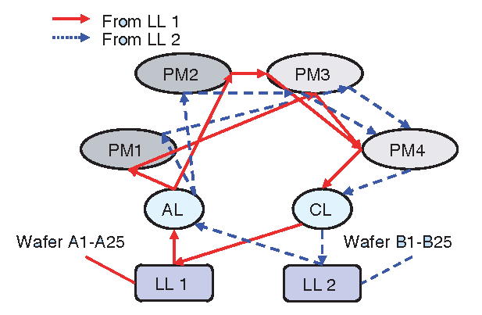
Conclusion
Add Title
You can simply impress your audience and add a unique zing and appeal to your Presentations. Easy to change colors, photos and Text.
For further consideration
반도체 설비 SW 內 웨이퍼 반송 Scheduler
現 Role 기반 운영 → RL 기반 운영 고려 가능

